Slide 1
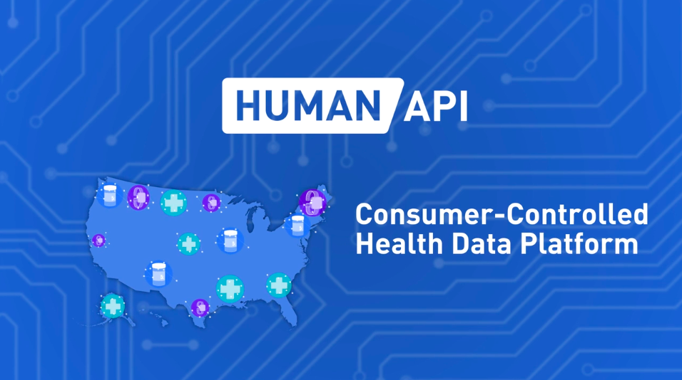

Slide 2
Why?
We exist to radically accelerate the pace of health innovation for everyone, everywhere.
How?
We create health data liquidity valued by customers and controlled by consumers.
What?
The first consumer-Controlled health data Platform.
built a health data platform that gives people a free, simple, transparent and secure way to connect & share health data with companies they trust.

Slide 3
Reason
-Why can't consumers easily access their own health data today?
-Why do innovators/enterprise struggle to connect health data together to build new technologies?
-Create a new kind of consumer-centric health ecosystem.

Slide 4
Customer Health Data:
Unstructured
Largely Fragmented
Slow to Procure
Expansive to access
Did the hard work of building manual integrations to thousands of fragmented health information systems in the U.S. and they normalized that unstructured data so they could deliver data in an actionable format to accelerate health innovation.

Slide 5
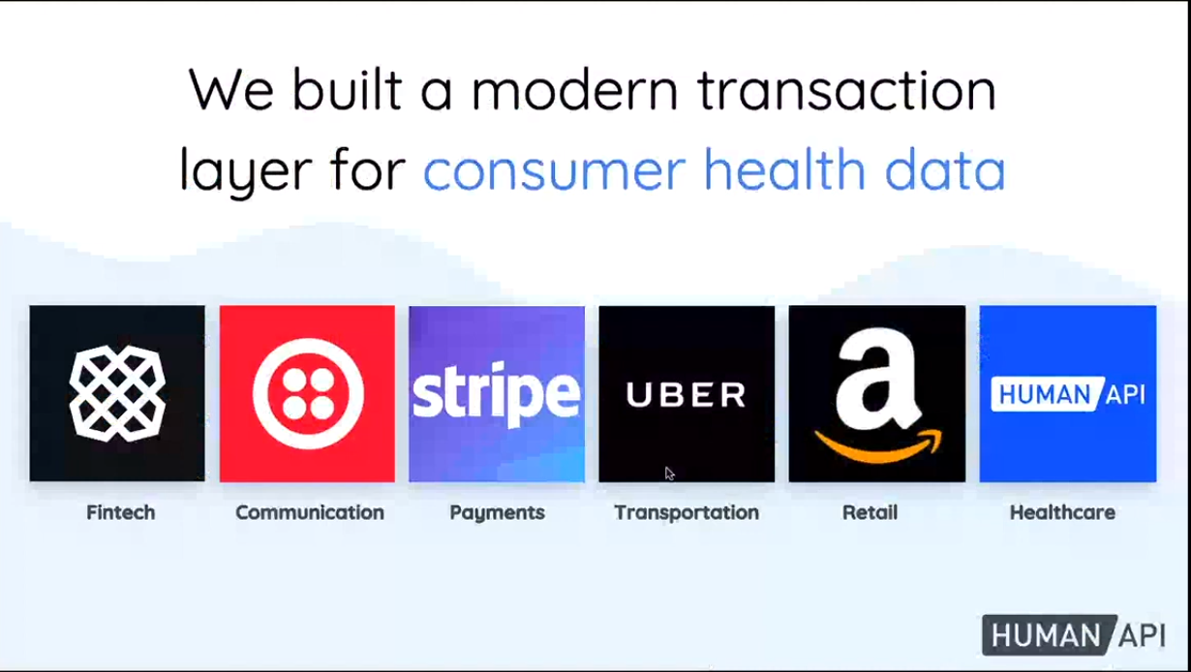

Slide 6
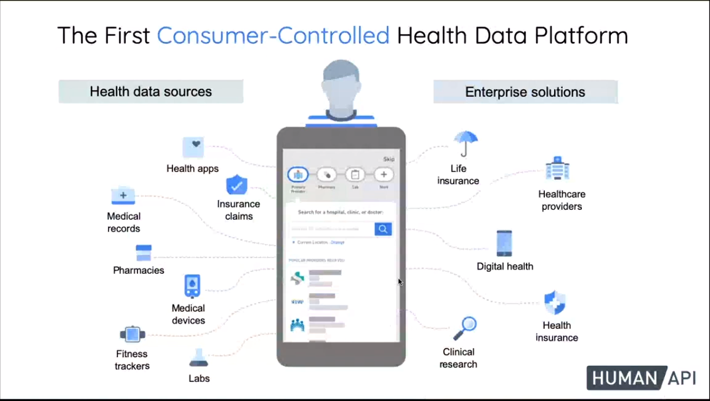

Slide 7
How extensive is your network reach?
28,000+ unique integrations across Medical Records, Pharmacies, Labs, Wellness in the U.S. and actively add new data sources to our platform.
300+ wearables & fitness apps across these major consumer-grade manufacturers .
Data Normalization
Unstructured and semi-structured data into a consistent output.
No matter what or how many sources the user connects, you'll end up with a single set of Human API credentials and one normalized API to query all of that user's data.

Slide 8
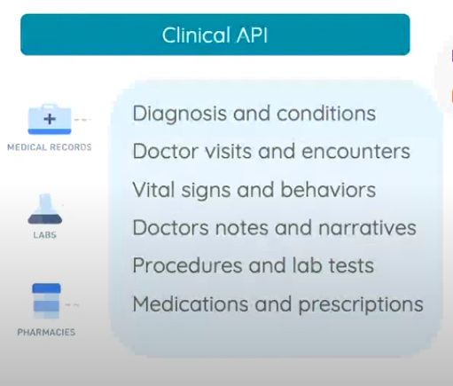
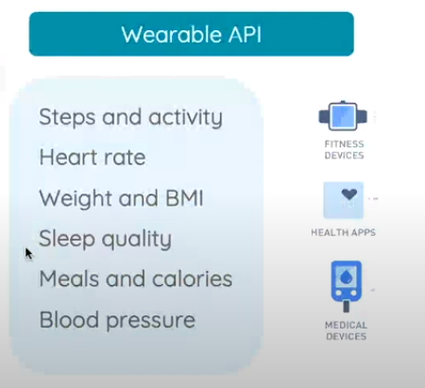
Restful APIs (https://reference.humanapi.co/v2.1/reference#getting-started)

Slide 9
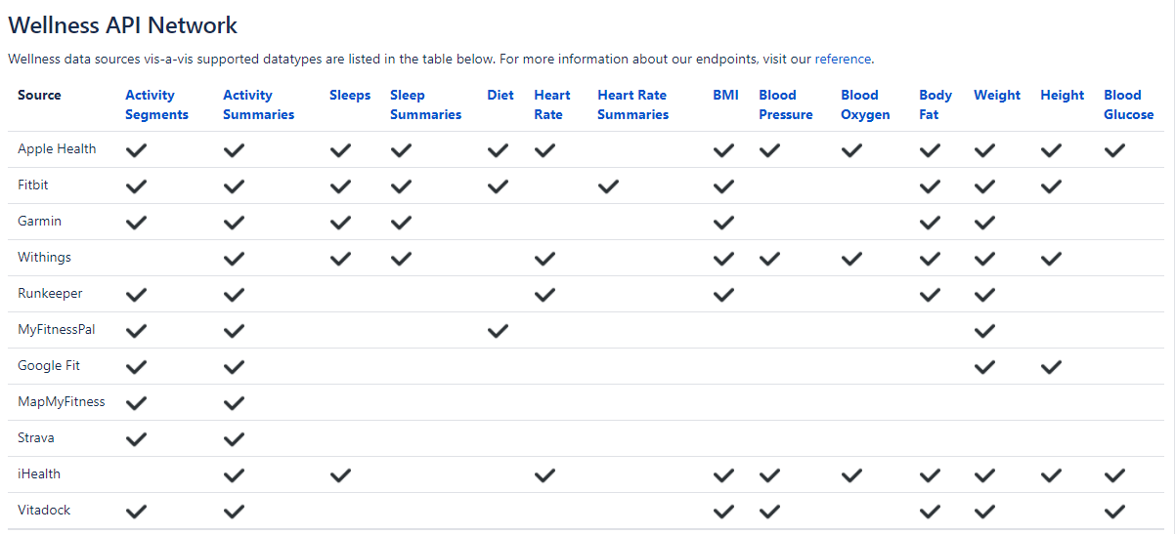

Slide 10
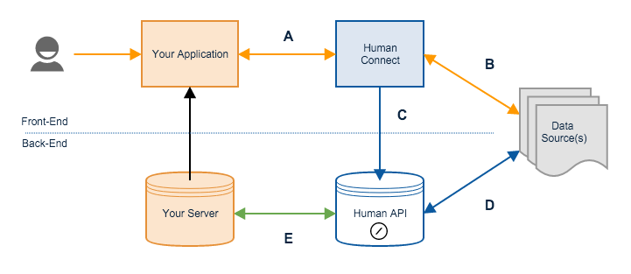
Human Connect:
The easiest way to connect your users' health data with your application or service.
Human Connect is an embeddable interface for applications to allow users to share their health data with your apps and services. After a user has successfully granted you access to their health data using Human Connect, you'll be able to query their data directly from Human API.

Slide 12
Omada:
Omada® empowers people to achieve their health goals through sustainable lifestyle change.
UCSF:
UCSF is a large academic health system that uses the Human API platform to connect patient data for clinical research and outcomes studies.
AAA Life Insurance:
The Human API data platform ingests and normalizes previously fragmented and unstructured consumers health data and delivers it to AAA life insurance in an actionable, structured format.
User Demo : https://www.youtube.com/watch?v=7i9LGKXg3z8

Slide 13
Thank you

